Slide 1
Radar Fabrication
By Anthony Bugatto

Slide 2
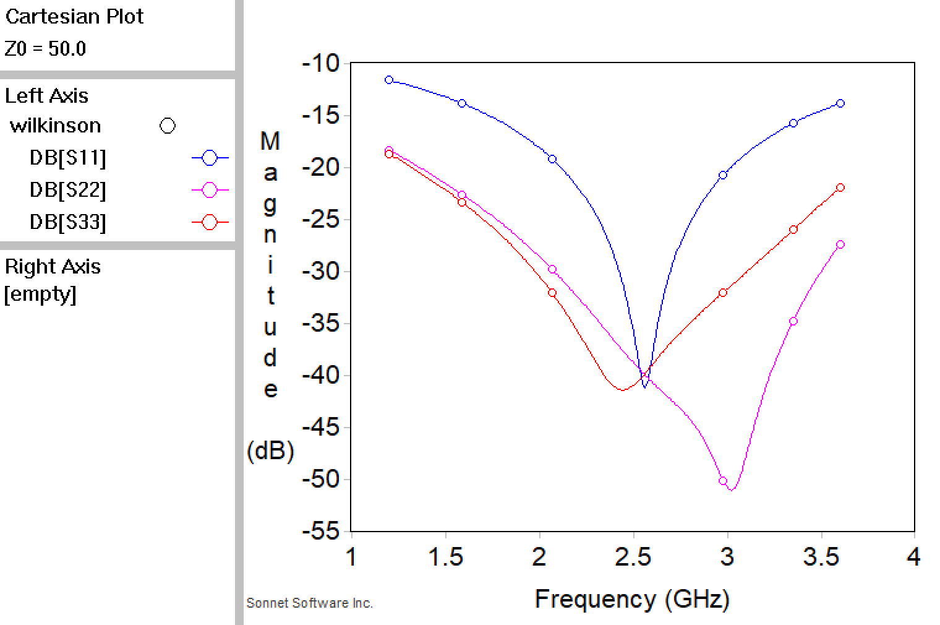
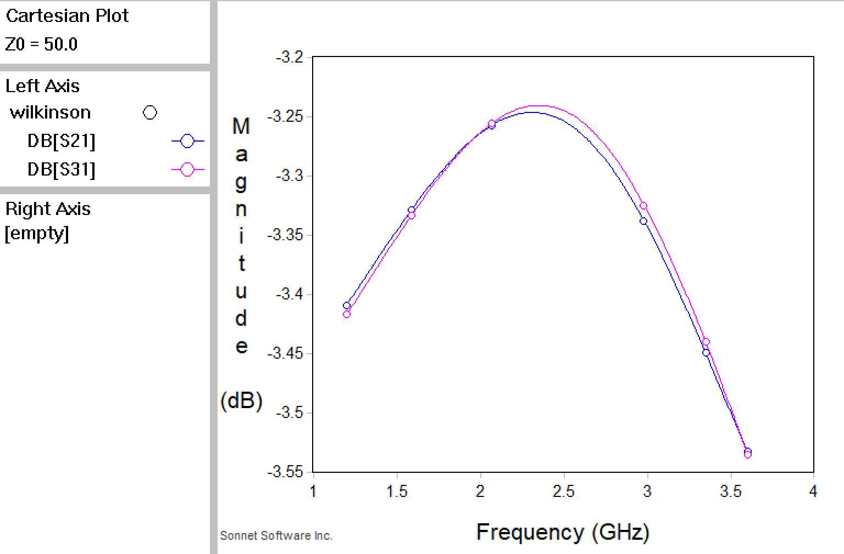
Quiz 1: Sonnet Wilkinson Power Divider

Slide 3
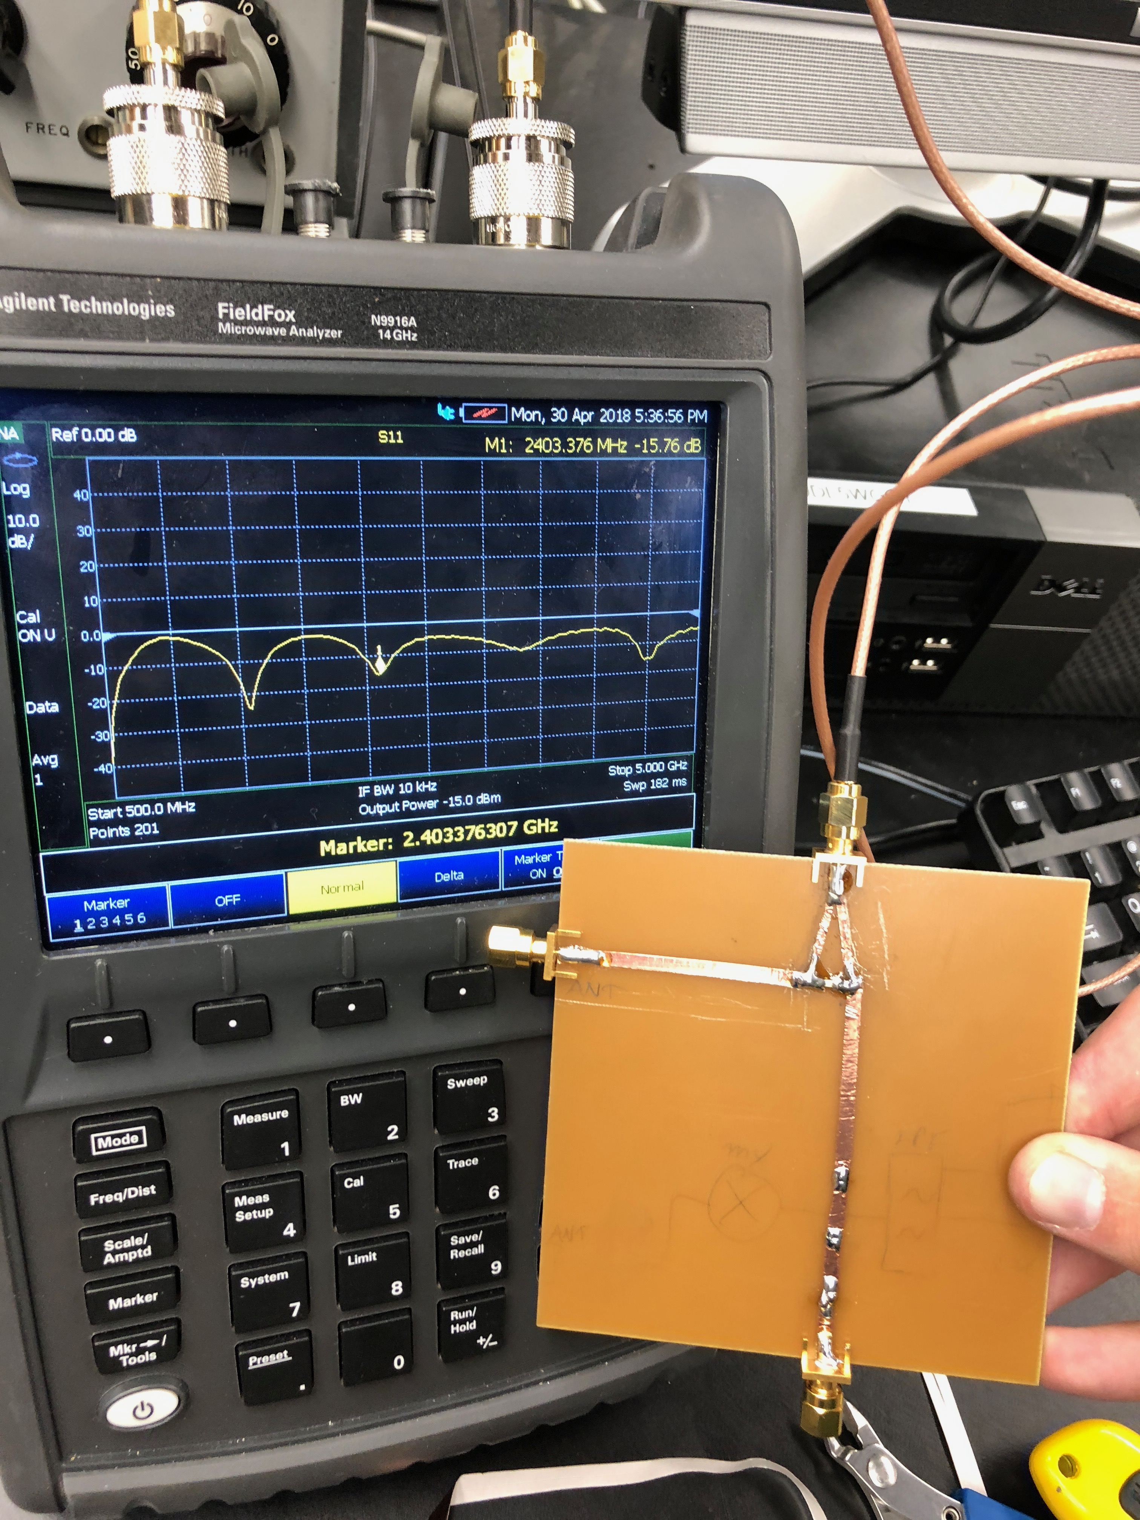
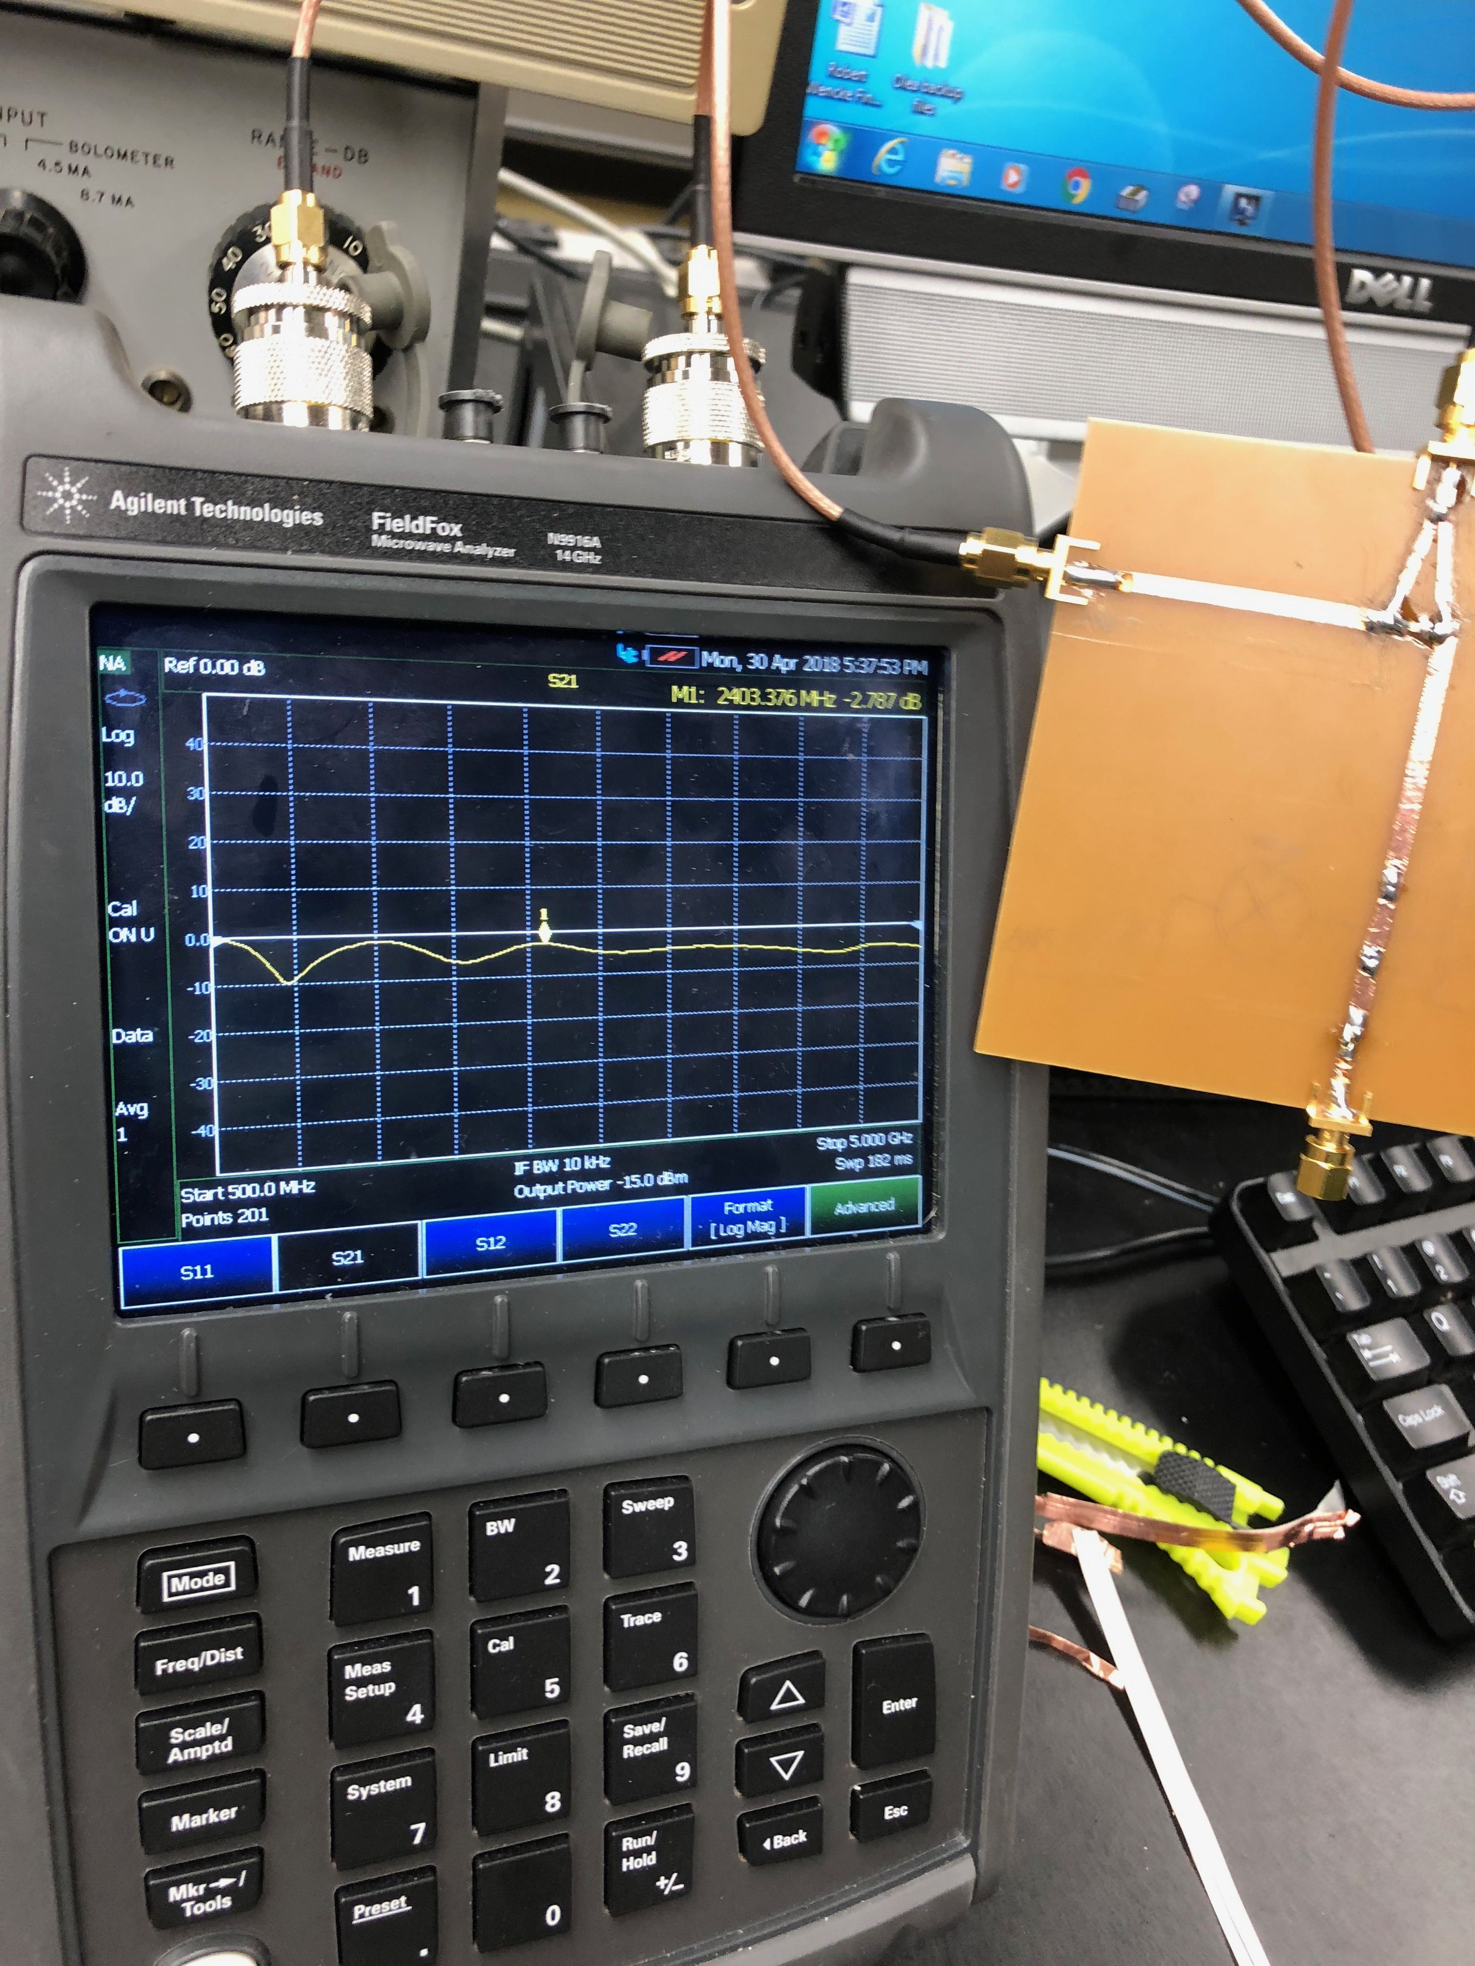
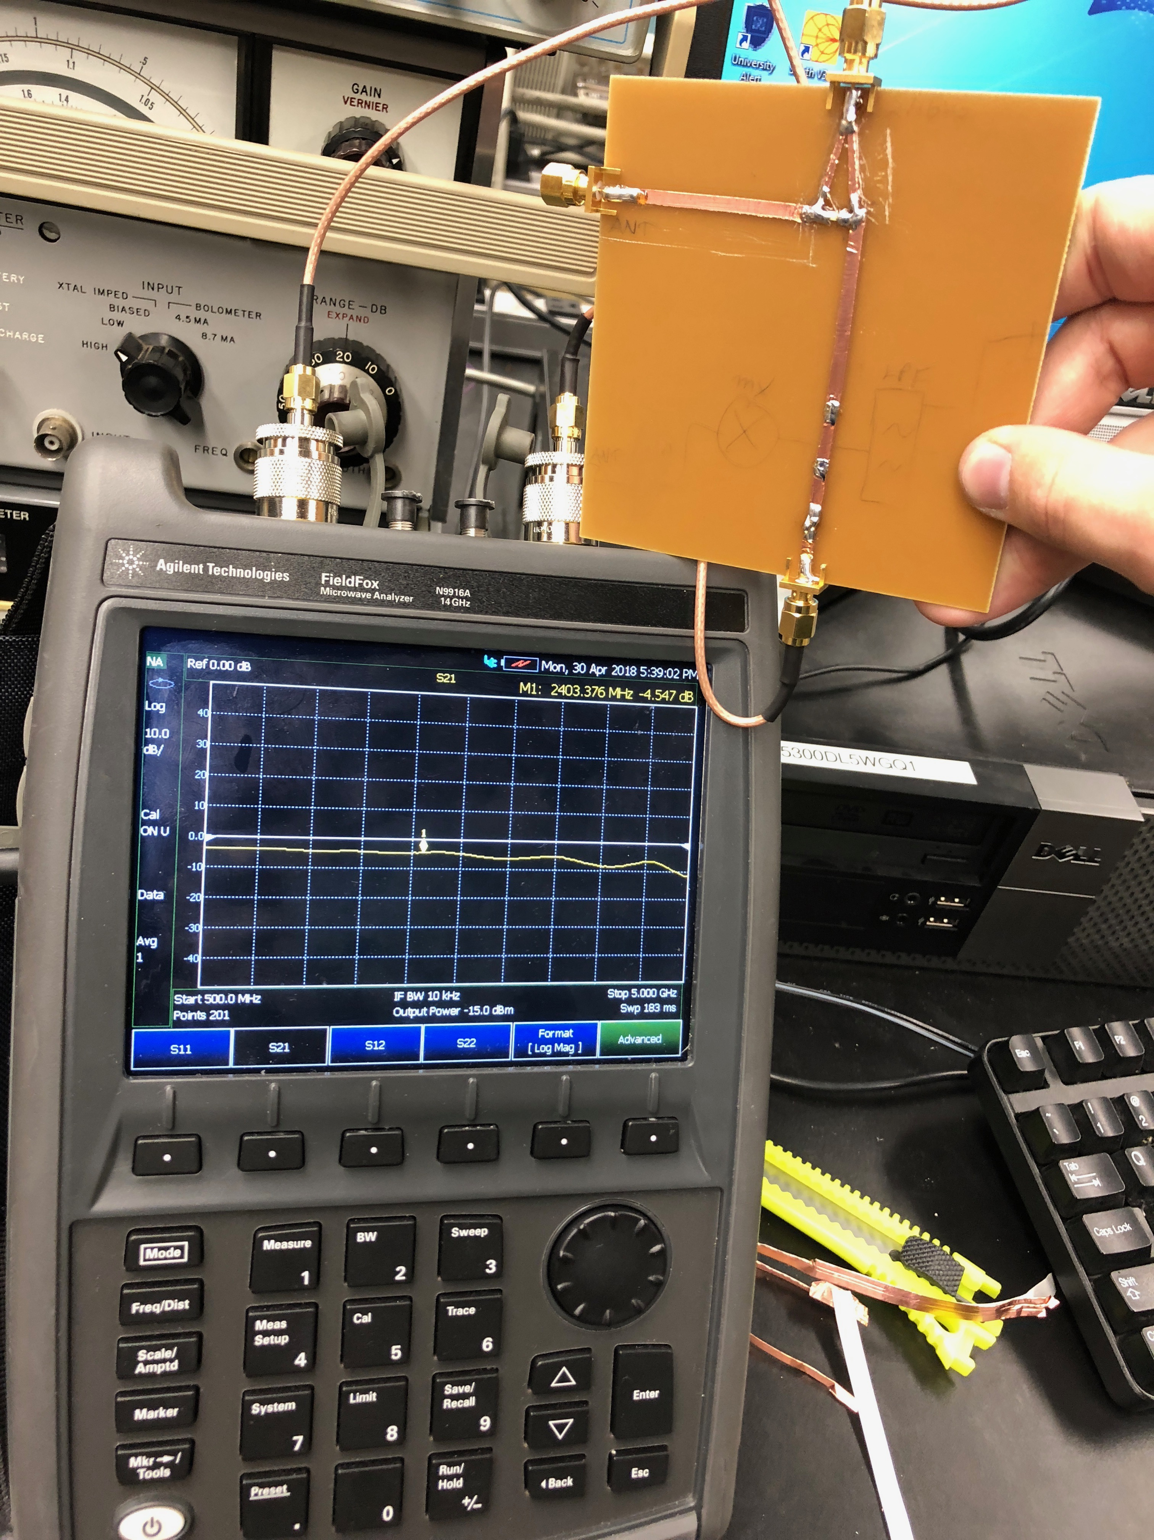
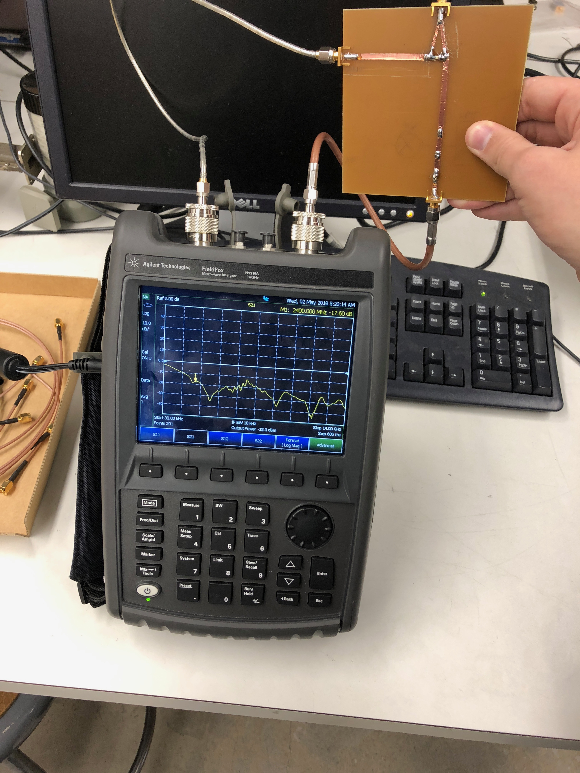
Quiz 2: Wilkinson Power Divider Fabrication
A: S11
B: S21
C: S31
D: S22 and S33

Slide 4
Quiz 2: Wilkinson Power Divider Results
The results look nearly identical to the simulation if you note that the network analyzer is measuring on a much larger scale. S11 is very close in that it has a steep attenuation at 2.4GHz, the only difference is that the result is about 20dB while the simulation is about 40dB. S21 and S31 are very accurate in that they are both very close to the 3dB half power attenuation required. S21 is 2.7dB and S31 is 4.8dB but I suspect that is because of the solder going to the port. S22 and S33 are both supposed to be very sharp attenuations of 40+dB. We can see this is evidenced by the simulation results.

Slide 5
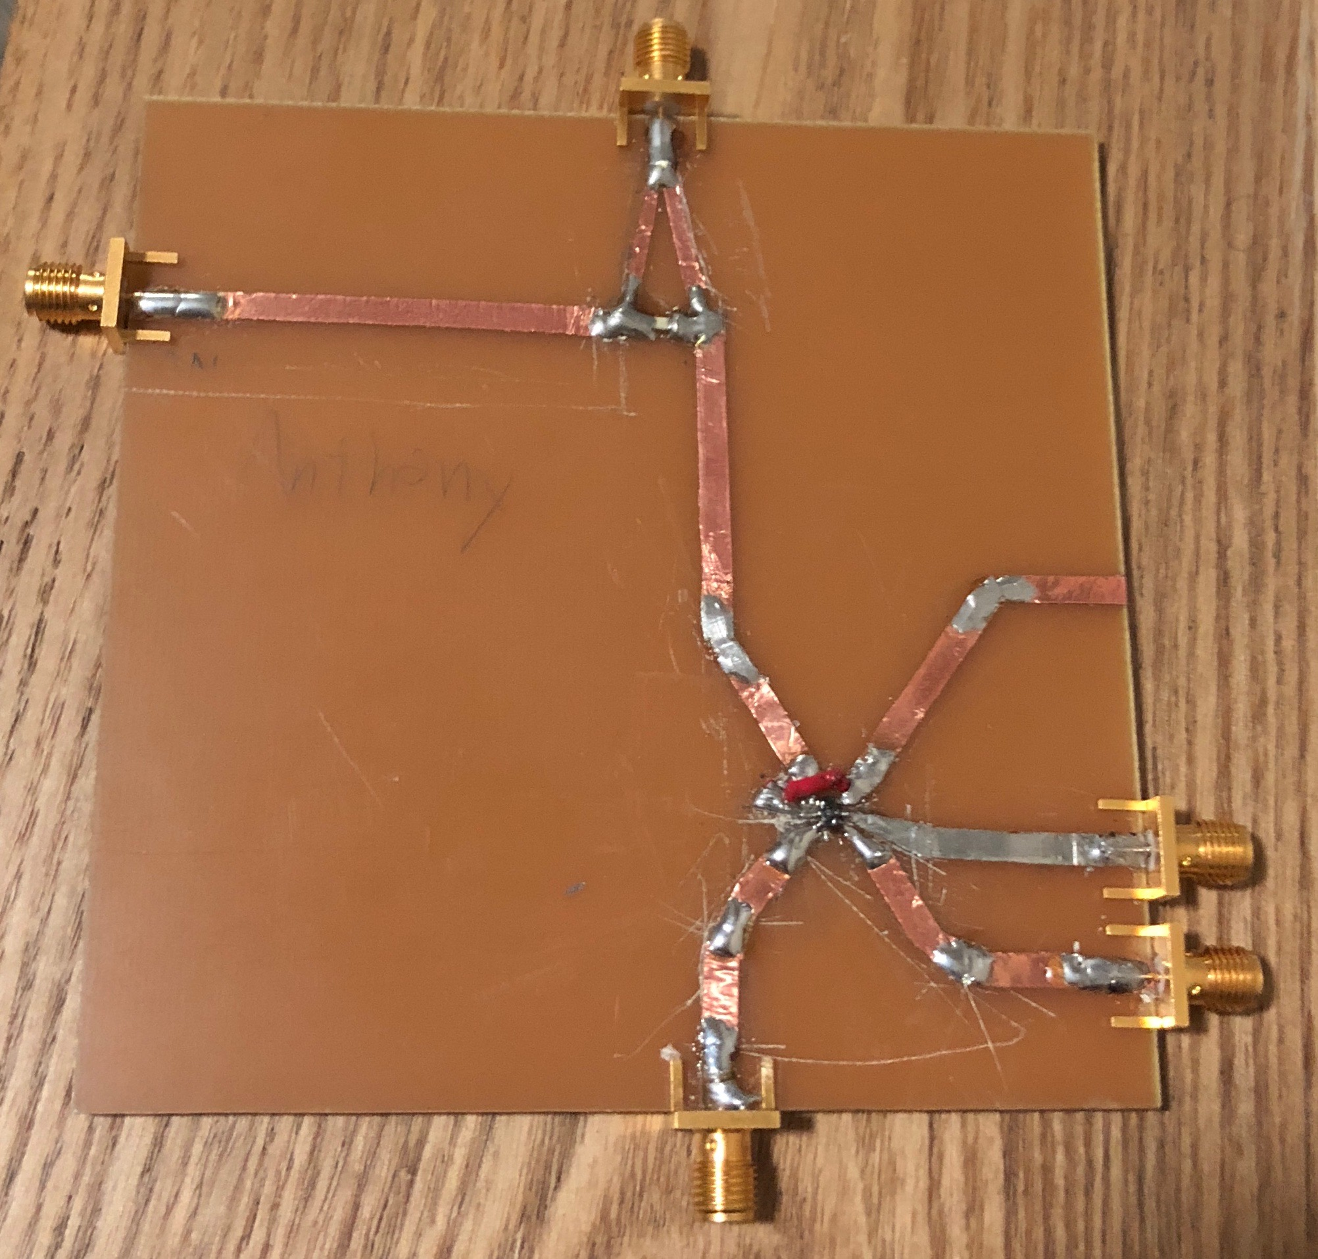
Quiz 3: Mixer Geometry

Slide 6
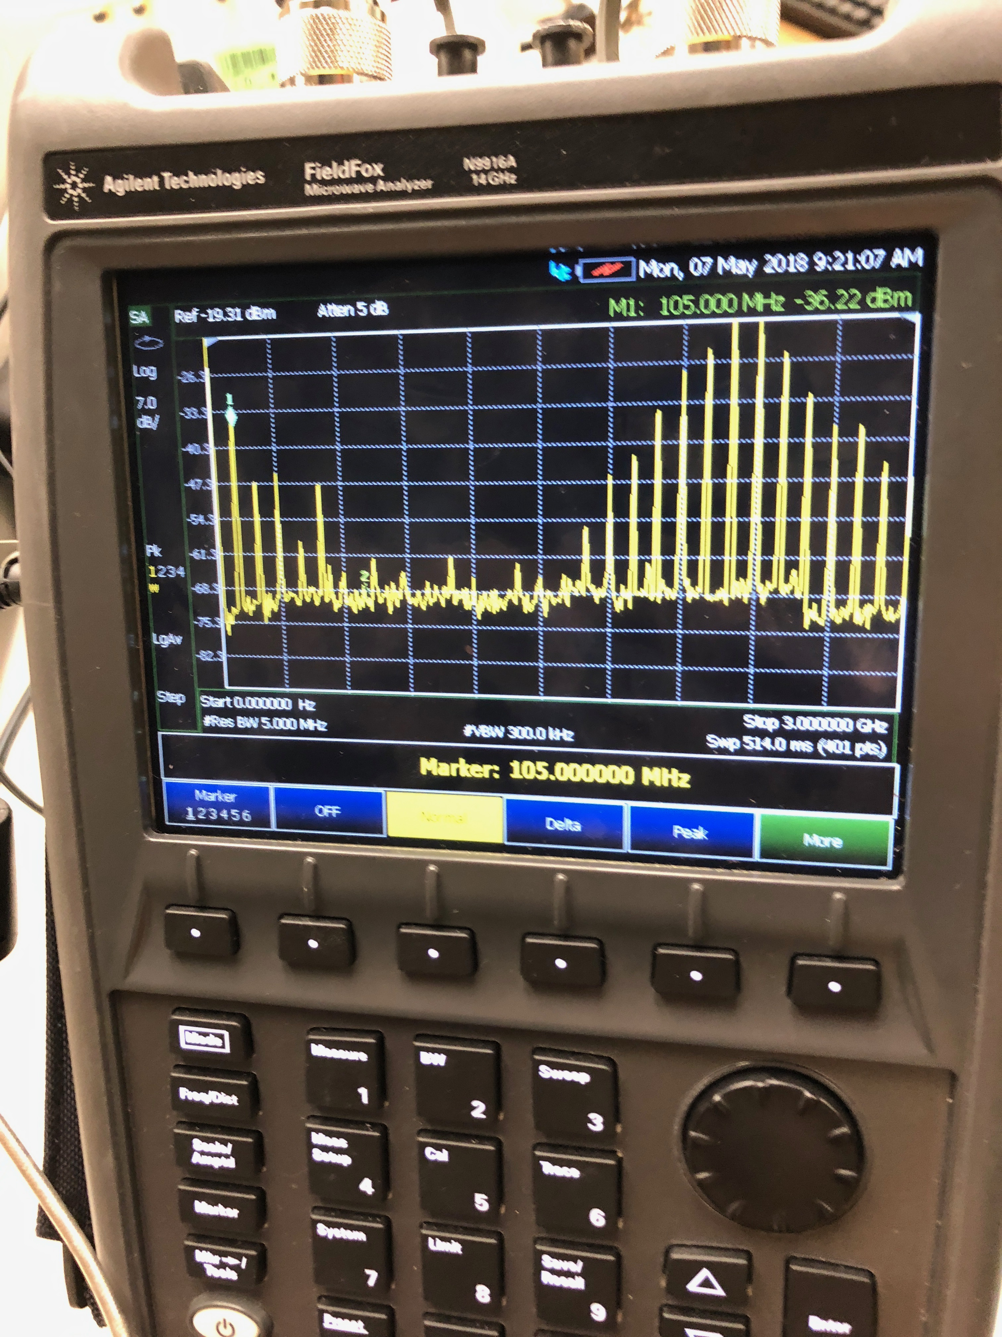
Quiz 3: Mixer Fabrication

Slide 7
Quiz 3: Mixer Results
The mixer results are very accurate to what is expected. A mixer is supposed to output the difference between the input signal and output signal (2.4GHz and 2.3GHz). It does this job very well and as you can see there are not only the necessary responses at a single frequency of 105MHz but all of the harmonics as well. In the next step we filter these harmonics out and get a clean response for the system.

Slide 8
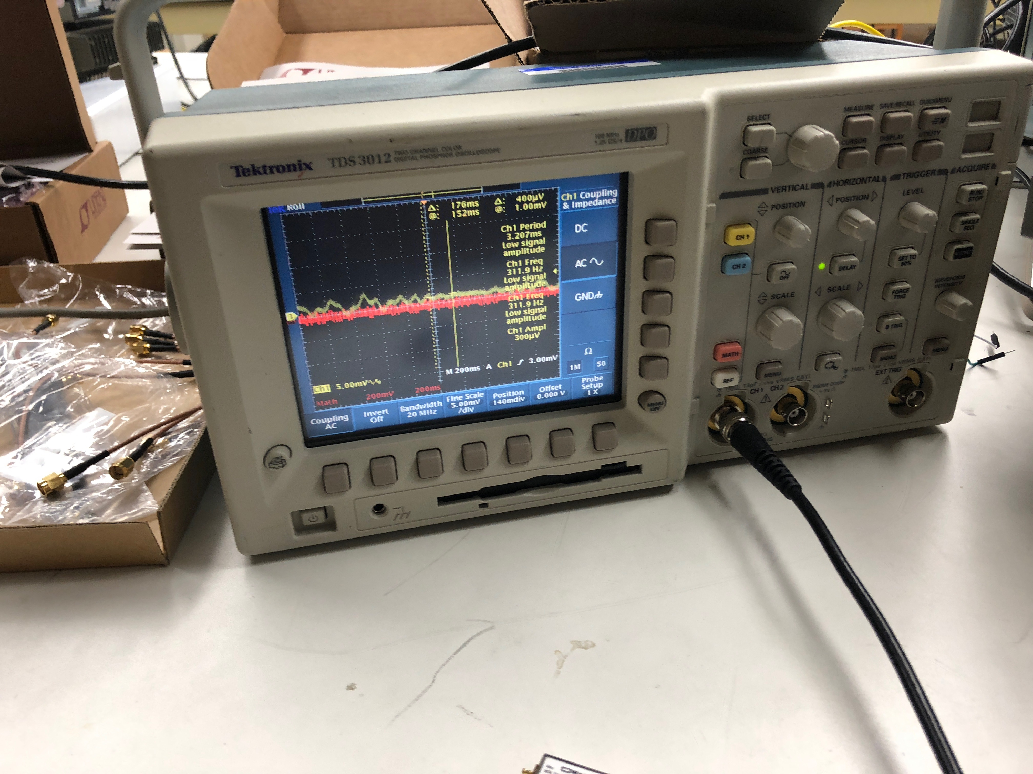
Quiz 4: Radar Test

Slide 9
Quiz 4: Radar Results
The radar works as expected when connected to a filter, amplifier, and antennas. What we would expect here is a peak when there is motion above the antennas. Just like the expected response we can see in the oscilloscope that on the left there are some peaks and valleys corresponding to waving my hand over the antennas that input into my circuit.

